Slide 1
Studi Kasus CRISP-DM Heating Oil Consumption – Attribute Correlation (Matthew North, Data Mining for the Masses, 2012, Chapter 4 Correlation, pp. 59-72)
Joko Suntoro
joko@jokosuntoro.com
SMS/Telp: 0822-4236-9670
WA/Telegram: 085-641-970-170
http://jokosuntoro.com

Slide 2

Joko Suntoro
SDN Pandean Lamper 03 Semarang (2001)
SMPN 32 Semarang (2004)
SMA Institut Indonesia Semarang (2007)
S1 Teknik Informatika Universitas Semarang (2010-2015)
S2 Teknik Informatika Universitas Dian Nuswantoro (2015-2016)
Tim Operasi dan Teknik, Domestic Gas PT Pertamina (Persero) (2008-sekarang)
Dosen dan Peneliti di Fakultas Teknologi Informasi dan Komunikasi Universitas Semarang
Peneliti dan Reviewer di Romi Satria Wahono (RSW) Intelligent System Research Group
Bidang Penelitian: Data Mining, Intelligent System dan Machine Learning

Slide 3
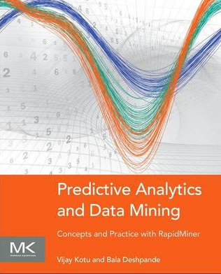


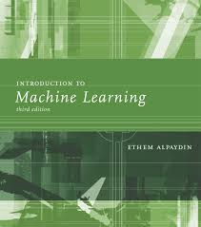
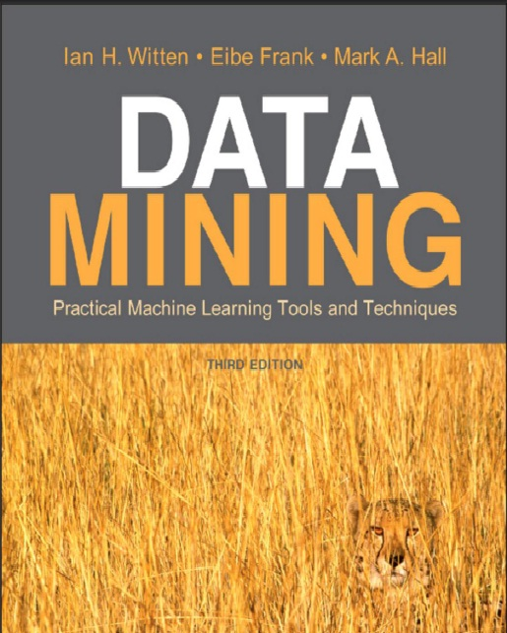
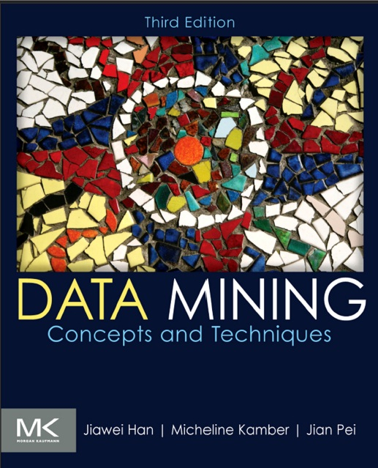
Textbooks

Slide 4
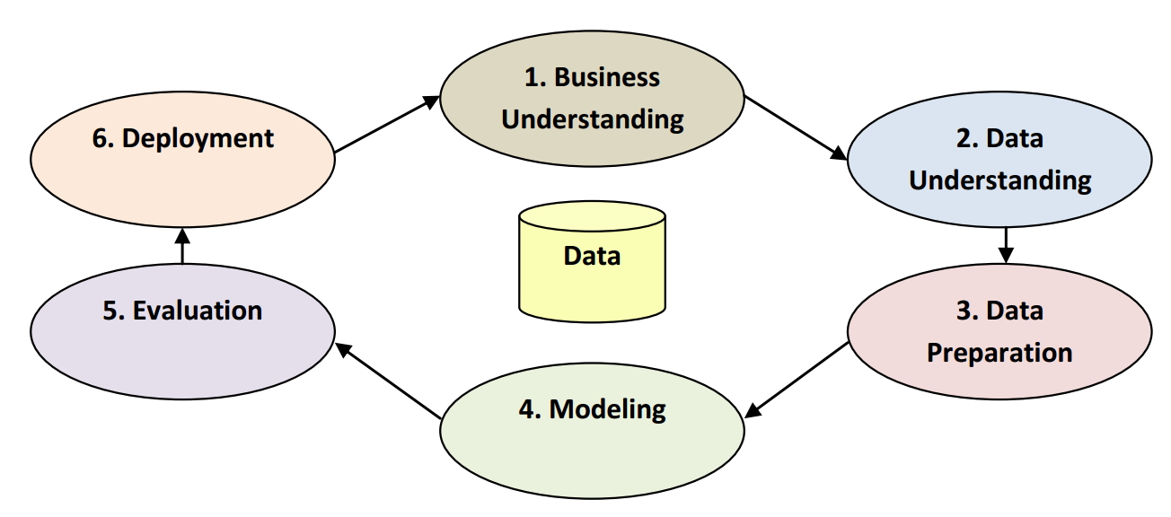
CRISP-DM

Slide 5
Context and Perspective
Sarah is a regional sales manager for a nationwide supplier of fossil fuels for home heating
Recent volatility in market prices for heating oil specifically, coupled with wide variability in the size of each order for home heating oil, has Sarah concerned
She feels a need to understand the types of behaviors and other factors that may influence the demand for heating oil in the domestic market
What factors are related to heating oil usage, and how might she use a knowledge of such factors to better manage her inventory, and anticipate demand?
Sarah believes that data mining can help her begin to formulate an understanding of these factors and interactions

Slide 6
1. Business Understanding
Sarah’s goal is to better understand how her company can succeed in the home heating oil market
She recognizes that there are many factors that influence heating oil consumption, and believes that by investigating the relationship between a number of those factors, she will be able to better monitor and respond to heating oil demand
She has selected correlation as a way to model the relationship between the factors she wishes to investigate
Correlation is a statistical measure of how strong the relationships are between attributes in a data set

Slide 7
2. Data Understanding
In order to investigate her question, Sarah has enlisted our help in creating a correlation matrix of six attributes
Using Sarah’s employer’s data resources which are primarily drawn from the company’s billing database, we create a data set comprised of the following attributes:
Insulation: This is a density rating, ranging from one to ten, indicating the thickness of each home’s insulation. A home with a density rating of one is poorly insulated, while a home with a density of ten has excellent insulation
Temperature: This is the average outdoor ambient temperature at each home for the most recent year, measure in degree Fahrenheit
Heating_Oil: This is the total number of units of heating oil purchased by the owner of each home in the most recent year
Num_Occupants: This is the total number of occupants living in each home
Avg_Age: This is the average age of those occupants
Home_Size: This is a rating, on a scale of one to eight, of the home’s overall size. The higher the number, the larger the home

Slide 8
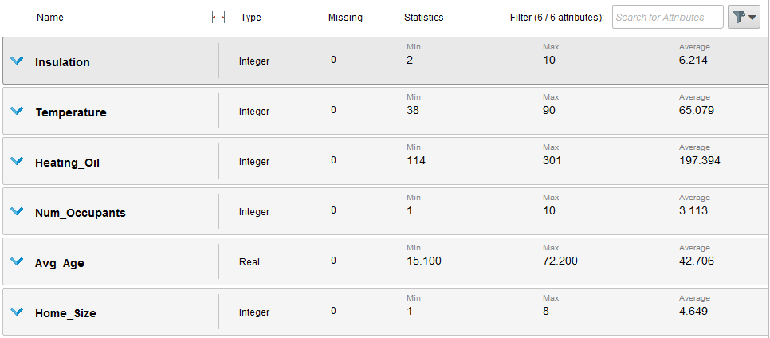
3. Data Preparation
Dataset: Chapter04DataSet.csv

Slide 9
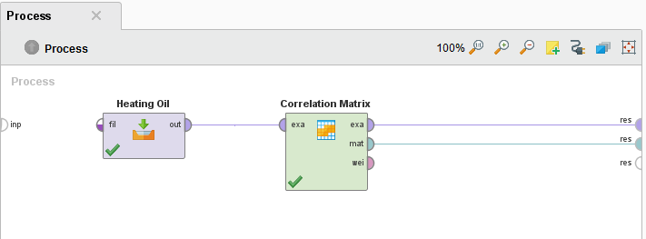
4. Modeling

Slide 10
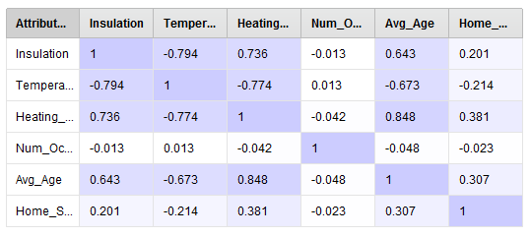
4. Modeling

Slide 11
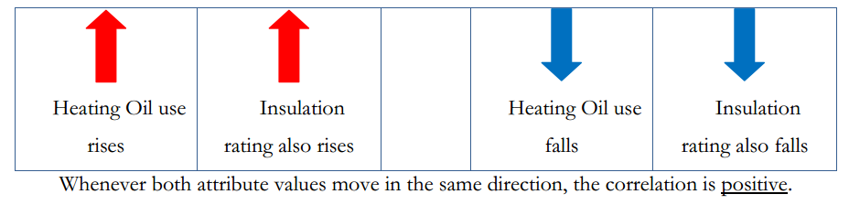
5. Evaluation
Illustration of positive correlations

Slide 12
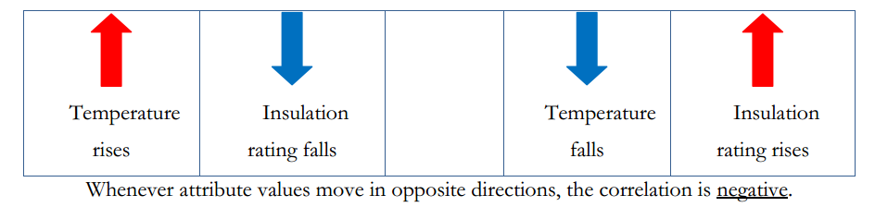
5. Evaluation
Illustration of negative correlations

Slide 13
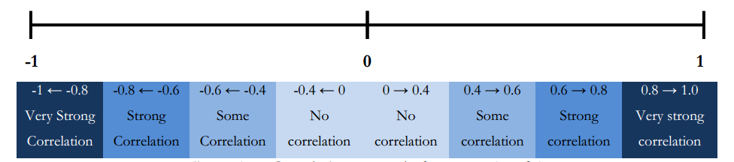
5. Evaluation
Correlation strengths between -1 and 1

Slide 14
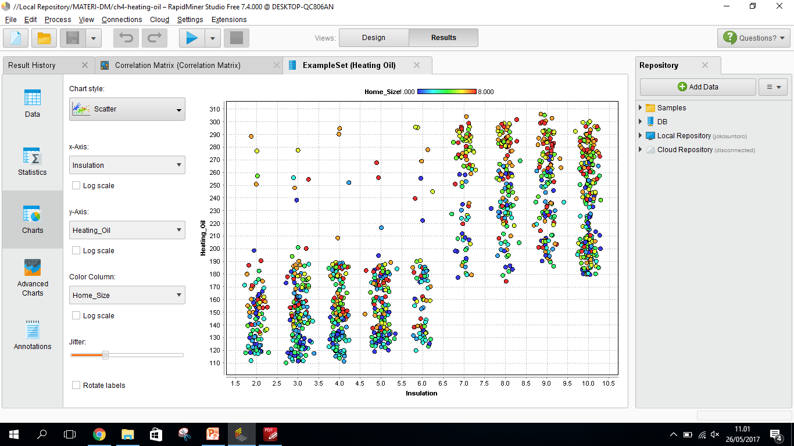
5. Evaluation

Slide 15
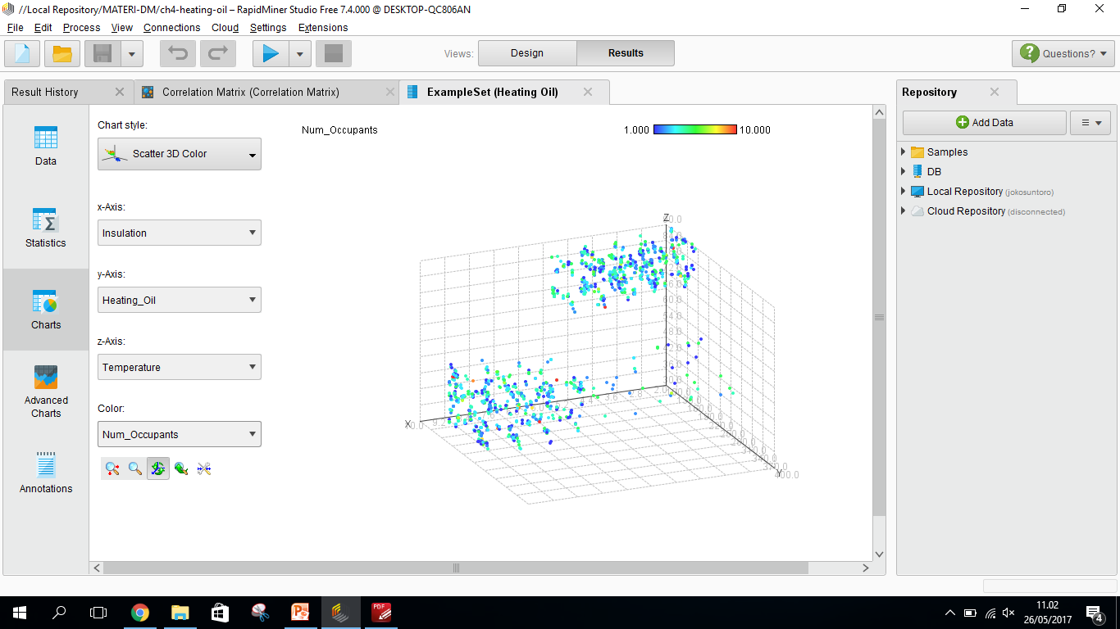
5. Evaluation

Slide 16
6. Deployment
Dropping the Num_Occupants attribute
While the number of people living in a home might logically seem like a variable that would influence energy usage, in our model it did not correlate in any significant way with anything else
Sometimes there are attributes that don’t turn out to be very interesting

Slide 17
6. Deployment
Investigating the role of home insulation
The Insulation rating attribute was fairly strongly correlated with a number of other attributes
There may be some opportunity there to partner with a company that specializes in adding insulation to existing homes

Slide 18
6. Deployment
Adding greater granularity in the data set
This data set has yielded some interesting results, but it’s pretty general
We have used average yearly temperatures and total annual number of heating oil units in this model
But we also know that temperatures fluctuate throughout the year in most areas of the world, and thus monthly, or even weekly measures would not only be likely to show more detailed results of demand and usage over time, but the correlations between attributes would probably be more interesting
From our model, Sarah now knows how certain attributes interact with one another, but in the day-to-day business of doing her job, she’ll probably want to know about usage over time periods shorter than one year

Slide 19
6. Deployment
Adding additional attributes to the data set
It turned out that the number of occupants in the home didn’t correlate much with other attributes, but that doesn’t mean that other attributes would be equally uninteresting
For example, what if Sarah had access to the number of furnaces and/or boilers in each home?
Home_size was slightly correlated with Heating_Oil usage, so perhaps the number of instruments that consume heating oil in each home would tell an interesting story, or at least add to her insight

Slide 20
Referensi
Bache, K., & Lichman, M. (2013). UCI Machine Learning Repository. Retrieved from http://www.ics.uci.edu/~mlearn/MLRepository.html
Ethem Alpaydin. Introduction to Machine Learning. 3rd ed. MIT Press. 2014
Harrington, P. (2012). Machine Learning in Action. United States of America: Manning Publications Co.
Hofmann, M., & Klinkenberg, R. (2013). Rapid Miner Data Mining Use Cases and Business Analytics Applications. CRC Press Taylor & Francis Group
Ian H. Witten, Frank Eibe, Mark A. Hall. Data mining: Practical Machine Learning Tools and Techniques 3rd Edition. Elsevier. 2011
Jiawei Han and Micheline Kamber. Data Mining: Concepts and Techniques Third Edition. Elsevier. 2012
Lantz, Brett. Machine Learning with R. Packt Publishing. 2013
Larose, D. T. (2006). Data Mining Methods and Models. Data Mining Methods and Models. Canada: Willey Publishing, Inc.
Noth, Matthew. Data Mining for The Masses. Creative Commons Attribution. 2012
V. Kotu, Predictive analytics and data mining. USA: Elsevier Inc., 2015.
Wahono, R. S. (2016). Computing Courses Data Mining. Retrieved from http://romisatriawahono.net/dm/

